Slide 1

Developing Effective Communications
L01

Slide 2
Steps in Developing Effective Communications
Identify Target Audience
Determine Objectives
Design Communications
Select Channels
Establish Budget
Decide on Media Mix
Measure Results
Manage Integrated Marketing Communications

Slide 3
Set The Communication Objectives
Establish need for a category
Build brand awareness
Build brand attitude
Influence brand purchase intention

Slide 4
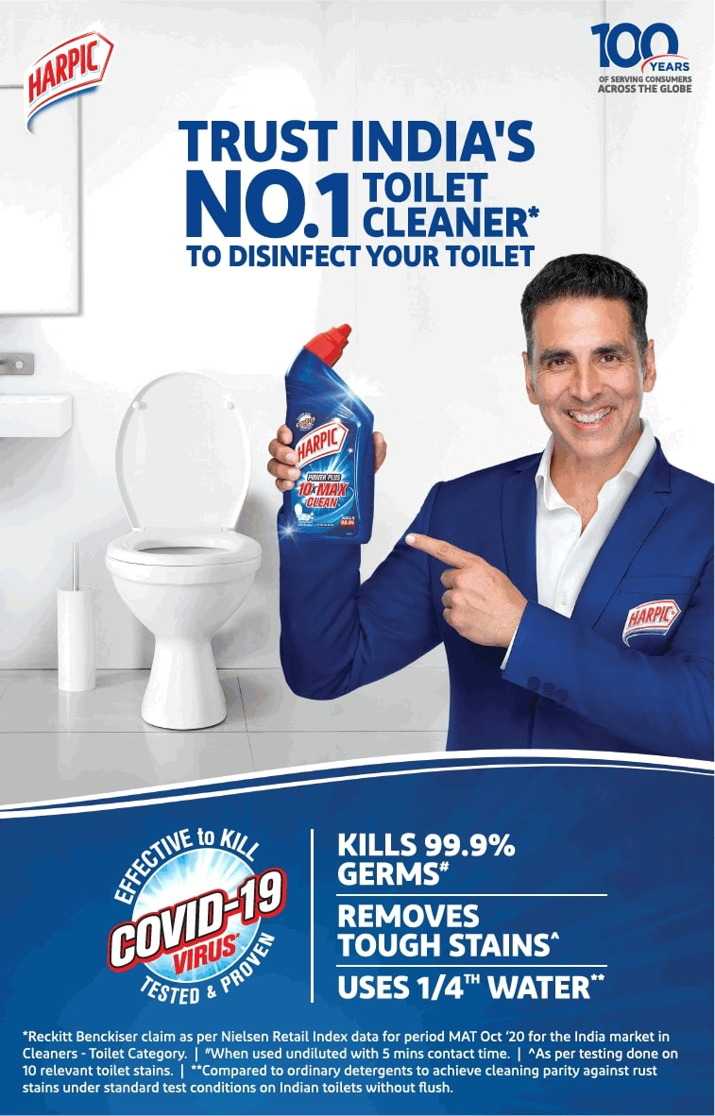

How Are These Communications Different?

Slide 5
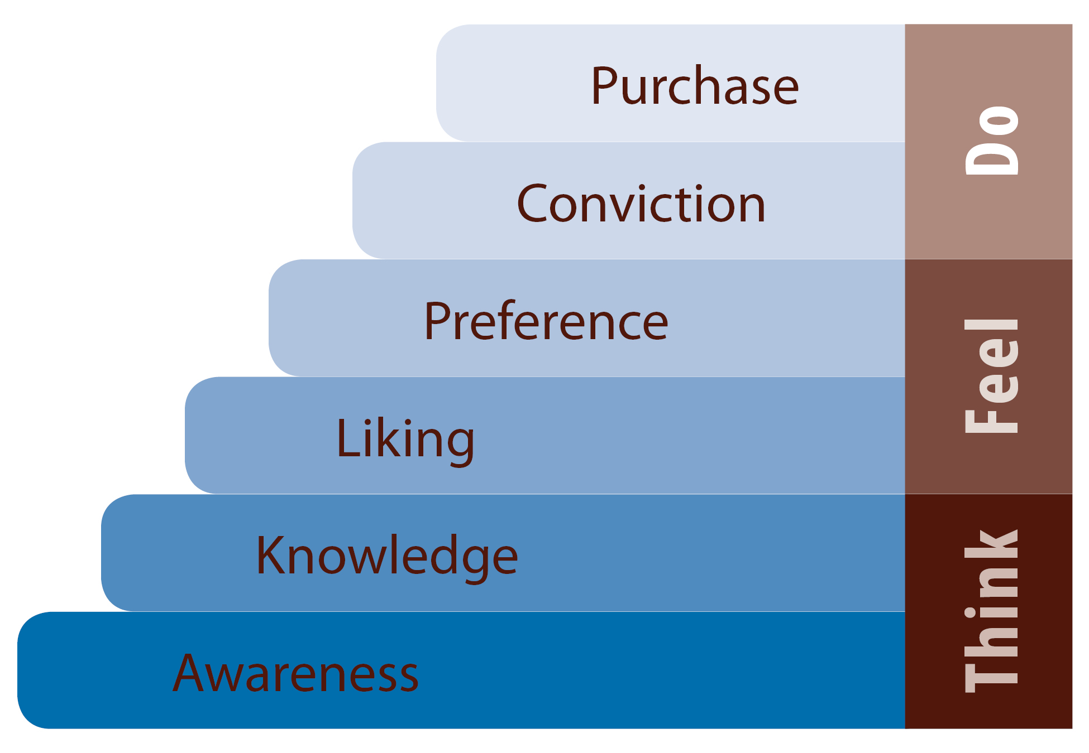
Hierarchy-of-Effects Theory
Awareness
Knowledge
Liking
Preference
Conviction
Purchase

Slide 6
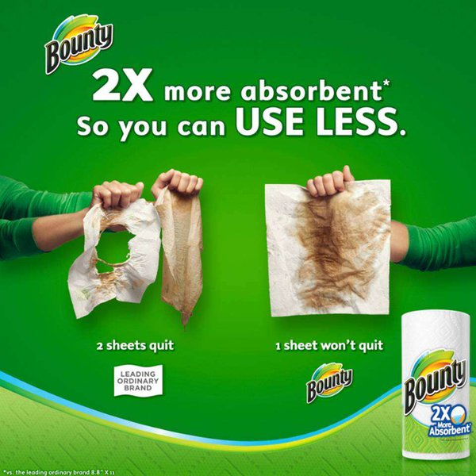


Design The Communications
Message Strategy
Creative Strategy
Informational Appeal
Transformational Appeal
Message Source

Slide 7
Select the Communication Channels
Personal
Direct marketing
Personal Selling
WoM
Non-Personal
Mass Media

Slide 8
Establish Total Marketing Communications Budget
Affordable Method
Percentage of Sales Method
Competitive Parity Method
Objective and Task Method

Slide 9
Selecting the Marketing Communications Mix
Advertising
Sales Promotion
Events and Experiences
PR and Publicity
Online and Social Media Marketing
Mobile Marketing
Direct and Database Marketing
Personal Selling

Slide 10
Factors in Setting Up the Communication Mix
Type of Product Market
Buyer Readiness Stage
Product Life-Cycle Stage

Slide 11
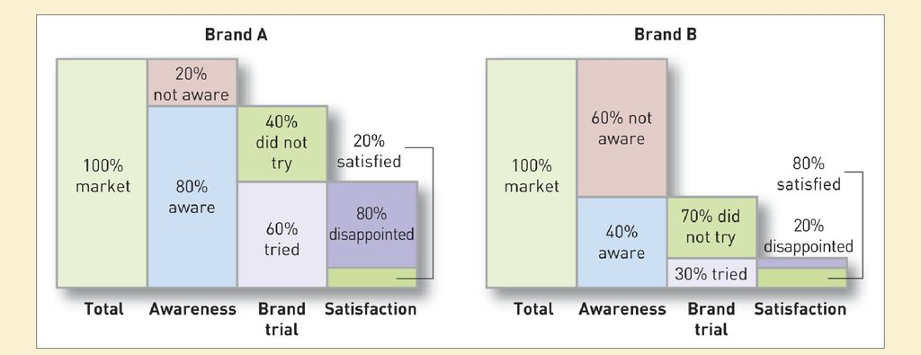
Measuring Communication Results

Slide 12
Managing IMC
Coordinating Media
Implementing IMC

Slide 13
QUESTIONS?
Write to me @ rajesh.19435@lpu.co.in

